Slide 1

Image Processing

Slide 2
Computer Vision with Python
Section Goals
Learn various image processing operations.
Perform image operations such as Smoothing, Blurring, Morphological Operations.
Grab properties such as color spaces and histograms.

Slide 3
Colorspaces

Slide 4
Computer Vision with Python
So far we’ve only worked with RGB color spaces, in RGB coding, colors are modeled as a combination of Red, Green, and Blue.
In the 1970s HSL (hue, saturation, lightness) and HSV (hue, saturation, value) were developed as alternative color models.

Slide 5
Computer Vision with Python
HSL and HSV are more closely aligned with the way human vision actually perceives color.
While in the course we will deal almost exclusively with RGB images, its a good idea to understand how to convert to HSL and HSV colorspaces.

Slide 6
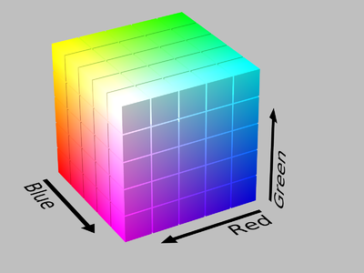
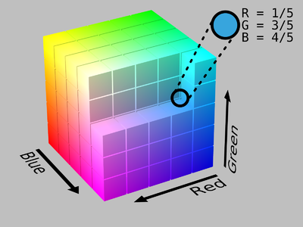
Computer Vision with Python
RGB Model Representation of Colors

Slide 7
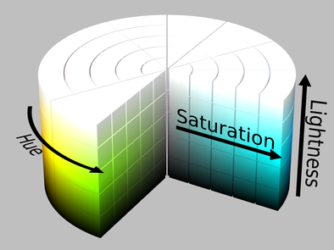
Computer Vision with Python
HSL Cylinder Model

Slide 8
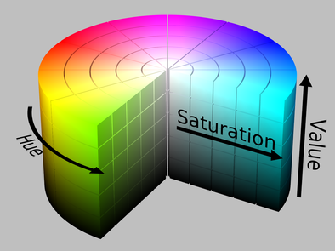
Computer Vision with Python
HSV Cylinder Model

Slide 9
Computer Vision with Python
This lecture will be a quick review on using the cvtColor function to change colorspaces.
We won’t have to deal with HSL or HSV based color images in the rest of the course.

Slide 10
Blending and Pasting Images

Slide 11
Computer Vision with Python
Often we will be working with multiple images.
OpenCV has many programmatic methods of blending images together and pasting images on top of each other.

Slide 12
Computer Vision with Python
Blending images is done through the addWeighted function that uses both images and combines them.
To blend images we use a simple formula:
new_pixel = α × pixel_1 + β × pixel_2 + γ

Slide 13
Computer Vision with Python
Let’s explore the syntax in this lecture!

Slide 14
Blending and Pasting Images - Part Two

Slide 15
Computer Vision with Python
So far we’ve seen how to “overlay” images on top of each other by simply replacing values of the larger image with values of the smaller image for a desired ROI.
But what if we only want to blend or replace part of the image?

Slide 16
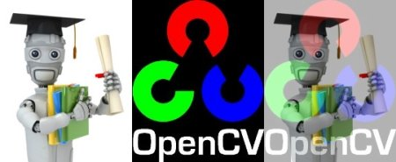
Computer Vision with Python
Operations we’ve done so far:

Slide 17
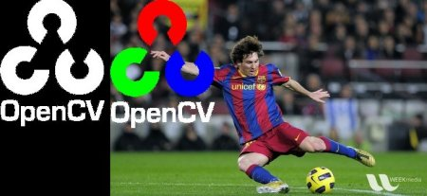
Computer Vision with Python
But what if we want to mask part of the smaller image?
Img 1
Mask
Img 2 with masked Img1

Slide 18
Computer Vision with Python
Let’s explore the syntax for these steps!
Keep in mind, it is quite complicated!
There are 3 really good supplemental links at the bottom of the lecture notebook for you to explore for other use cases.

Slide 19
Image Thresholding

Slide 20
Computer Vision with Python
In some CV Applications it is often necessary to convert color images to grayscale, since only edges and shapes end up being important.
Similarly, some applications only require a binary image showing general shapes.

Slide 21
Computer Vision with Python
Thresholding is fundamentally a very simple method of segmenting an image into different parts.
Thresholding will convert an image to consist of only two values, white or black.

Slide 22
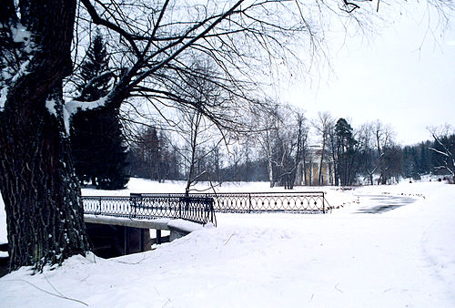
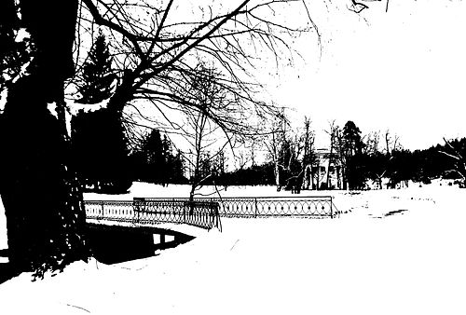
Computer Vision with Python
Converting a color image to binary.

Slide 23
Computer Vision with Python
Let’s explore the syntax and options for thresholding with OpenCV!

Slide 24
Blurring and Smoothing

Slide 25
Computer Vision with Python
A common operation for image processing is blurring or smoothing an image.
Smoothing an image can help get rid of noise, or help an application focus on general details.
There are many methods of blurring and smoothing.

Slide 26
Computer Vision with Python
Often blurring or smoothing is combined with edge detection.
Edge detection algorithms detect too many edges when shown a high resolution image without any blurring.

Slide 27
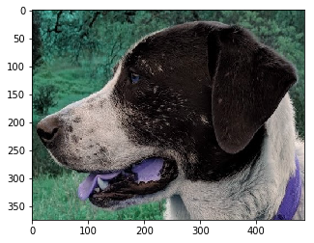
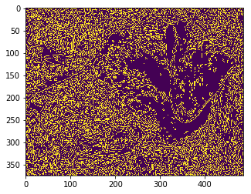
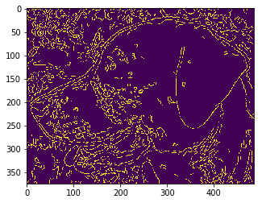
Computer Vision with Python
Often blurring or smoothing is combined with edge detection.
Original
Detected Edges (no blur)
Detected Edges (with blur)

Slide 28
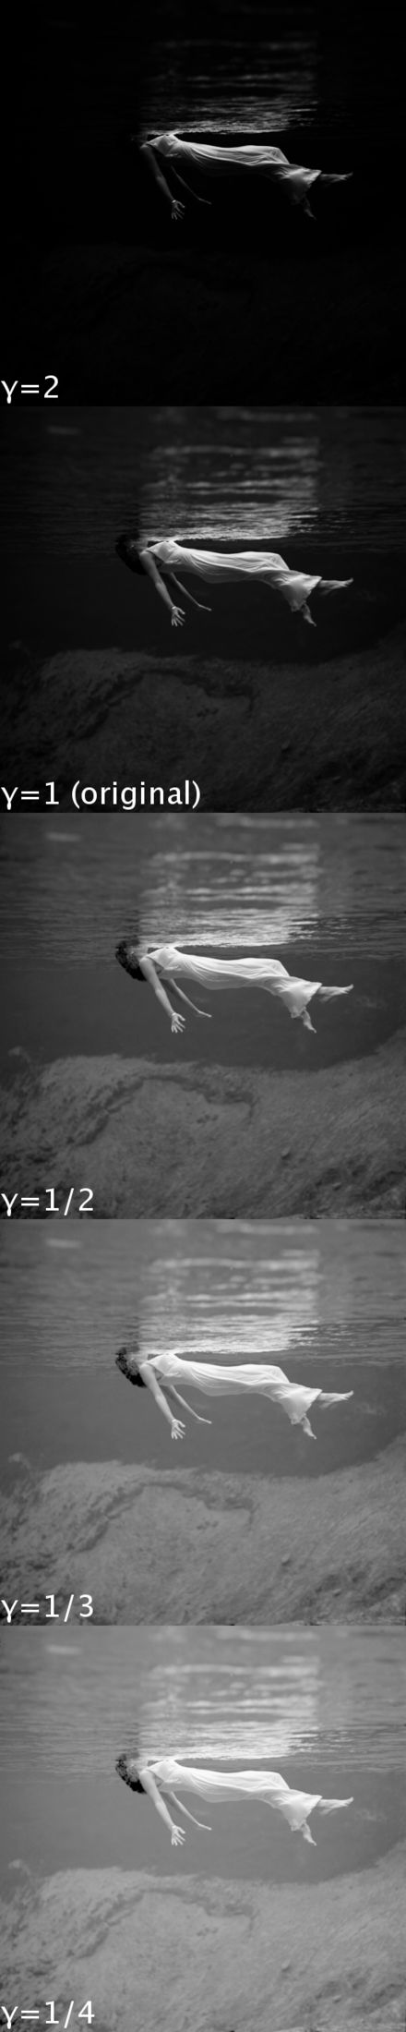
Computer Vision with Python
Methods we’ll be exploring
Gamma Correction
Gamma correction can be applied to an image to make it appear brighter or darker depending on the Gamma value chosen.

Slide 29
Computer Vision with Python
Methods we’ll be exploring
Kernel Based Filters
Kernels can be applied over an image to produce a variety of effects.
The best way to explain this is through an interactive visualization.
Go to: http://setosa.io/ev/image-kernels/

Slide 30
Blurring and Smoothing
Part Two

Slide 31
Morphological Operators

Slide 32
Computer Vision with Python
Morphological Operators are sets of Kernels that can achieve a variety of effects, such as reducing noise.
Certain operators are very good at reducing black points on a white background (and vice versa)

Slide 33
Computer Vision with Python
Certain operators can also achieve an erosion and dilation effect that can add or erode from an existing image.
This effect is most easily seen on text data, so we will practice various morphological operators on some simple white text on a black background.
Let’s get started!

Slide 34
Gradients

Slide 35
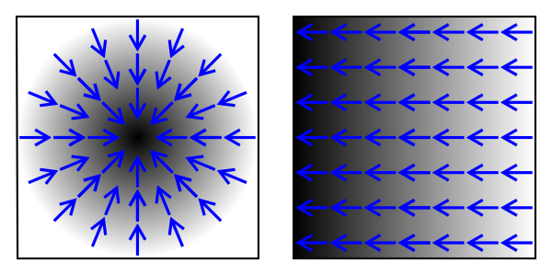
Computer Vision with Python
An image gradient is a directional change in the intensity or color in an image.

Slide 36
Computer Vision with Python
In this lecture we will mainly be exploring basic Sobel-Feldman Operators (often called Sobel for short)
Later on in the course we will expand on this operator for general edge detection.

Slide 37
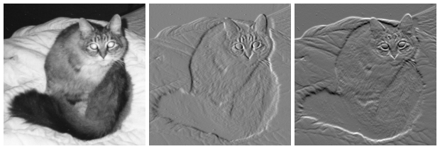
Computer Vision with Python
Gradients can be calculated in a specific direction.

Slide 38
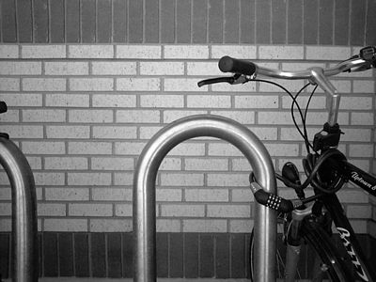
Computer Vision with Python
Here we see an image of a bike.
Let’s calculate some gradients!

Slide 39
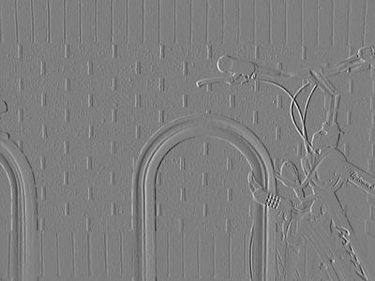
Computer Vision with Python
Normalized x-gradient from Sobel-Feldman Operator

Slide 40
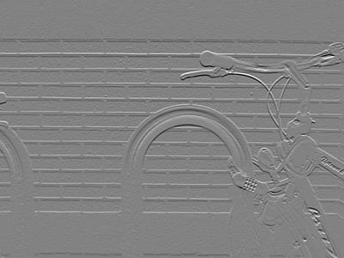
Computer Vision with Python
Normalized y-gradient from Sobel-Feldman Operator

Slide 41
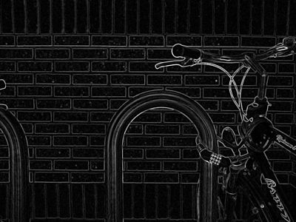
Computer Vision with Python
Normalized gradient magnitude from Sobel–Feldman operator

Slide 42
Computer Vision with Python
We will explore this sort of general edge detection in a future lecture.

Slide 43
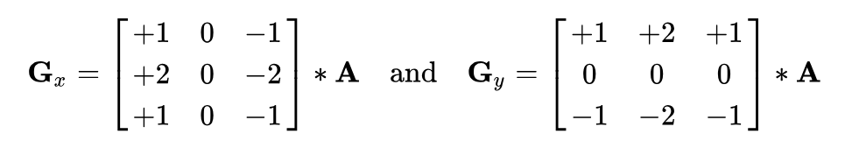
Computer Vision with Python
The operator uses two 3×3 kernels which are convolved with the original image to calculate approximations of the derivatives – one for horizontal changes, and one for vertical.

Slide 44
Computer Vision with Python
Check out the wikipedia article on the Sobel Operator for full math details.
For our use case, we will focus on understanding the syntax of using Sobel with OpenCV.

Slide 45
Computer Vision with Python
Let’s explore various gradient operators with OpenCV
We’ll also combine these concepts with a few other image processing techniques we’ve learned.

Slide 46
Histograms

Slide 47
Computer Vision with Python
Let’s first understand what a regular histogram is, then we’ll explain what an image histogram means.
A histogram is a visual representation of the distribution of a continuous feature.

Slide 48
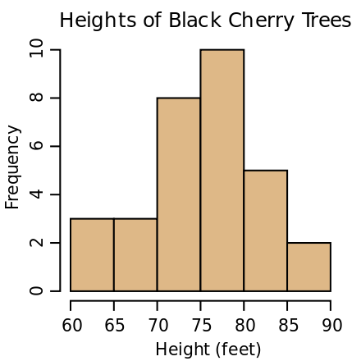
Computer Vision with Python
Simple example

Slide 49
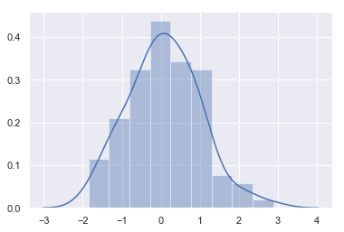
Computer Vision with Python
We can also display the general trend of the frequency.

Slide 50
Computer Vision with Python
For images, we can display the frequency of values for colors.
Each of the three RGB channels has values between 0-255.
We can plot these as 3 histograms on top of each other to see how much of each channel there is.

Slide 51
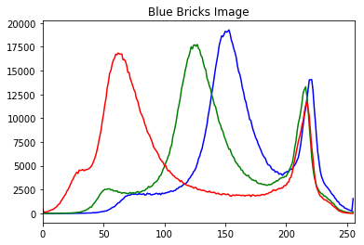
Computer Vision with Python
Example Image Histogram

Slide 52
Computer Vision with Python
Recall that 0 means pure black

Slide 53
Computer Vision with Python
Let’s explore how to create image histograms with matplotlib and OpenCV!

Slide 54
Histograms - Part Two

Slide 55
Computer Vision with Python
Let’s continue our discussion of histograms with two additional topics:
Histograms on a masked portion of the image
Histogram Equalization

Slide 56
Computer Vision with Python
As mentioned in the previous lecture, we can select an ROI and only calculate the color histogram of that masked section.
We’ll show how to create a mask and achieve this effect.

Slide 57
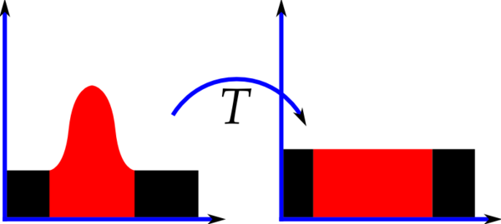
Computer Vision with Python
Histogram Equalization is a method of contrast adjustment based on the image’s histogram.

Slide 58

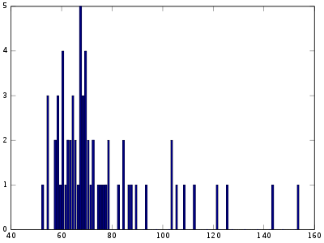
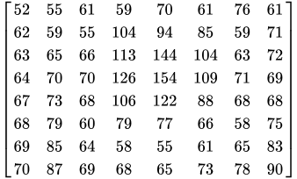
Computer Vision with Python
Example of an original image.

Slide 59
Computer Vision with Python
Applying histogram equalization will reduce the color depth (shades of gray)

Slide 60
Computer Vision with Python
Let’s take a look at the original min and max values

Slide 61
Computer Vision with Python
Let’s now apply histogram equalization (check the resource link for full math)

Slide 62
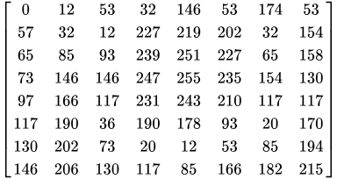

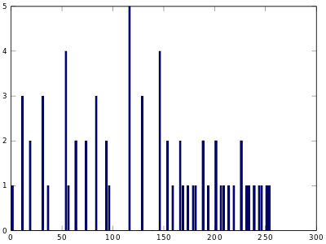
Computer Vision with Python
Let’s now apply histogram equalization (check the resource link for full math)

Slide 63
Computer Vision with Python
Notice how the min and max values have now been equalized to be 0 and 255.

Slide 64
Computer Vision with Python
We also now see less shades of gray (resulting in higher contrast)

Slide 65
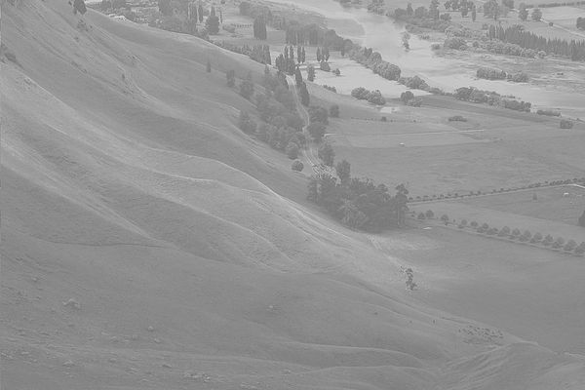
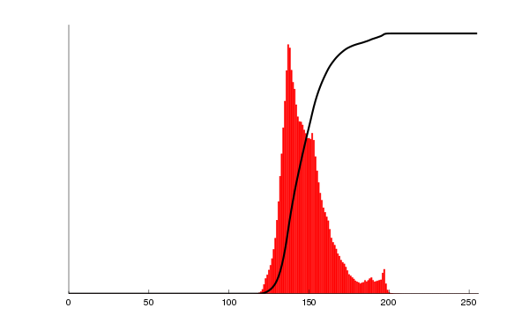
Computer Vision with Python
Let’s now see the results on a normal image

Slide 66
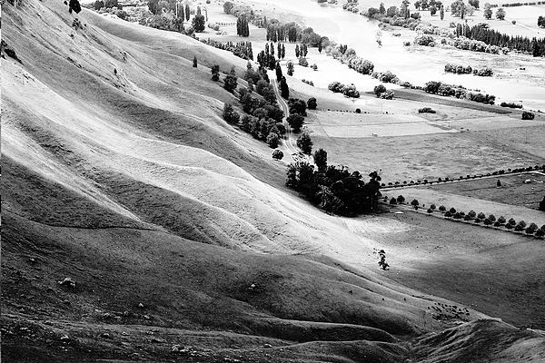
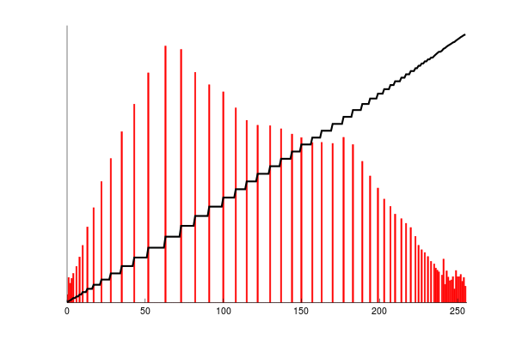
Computer Vision with Python
Let’s now see the results on a normal image

Slide 67
Computer Vision with Python
Corresponding histogram (red) and cumulative histogram (black)

Slide 68
Computer Vision with Python
Let’s explore this with OpenCV!

Slide 69
Image Processing
Assessment Overview

Slide 70
Image Processing
Assessment Solutions

